Slide 1
Air Quality
Jun Liu, Jiajun Wang

Slide 2
1. Introduction
Dataset:
US Pollution 2000-2021
CO, NO2, O3, and SO2 pollution data in the USA between 2000-2021 from the EPA
Dataset:
United States Cities Database
US GDP 1997 -2021
US Population 2020
LA Crime Records 2000-2021

Slide 3
Hypothesis Part A
1. Air pollution varies by region
- The cities with the worst air quality in the last 5 years are different from the cities with the worst average air quality in the past 20 years
- Air quality in U.S. cities has deteriorated considerably over the past 20 years
- Air quality in U.S. cities has improved a lot over the past 20 years
2. Air pollution has a time difference
- Air quality has changed significantly over the past 20 years
- Each air pollutant has a clear trend of change every year

Slide 4
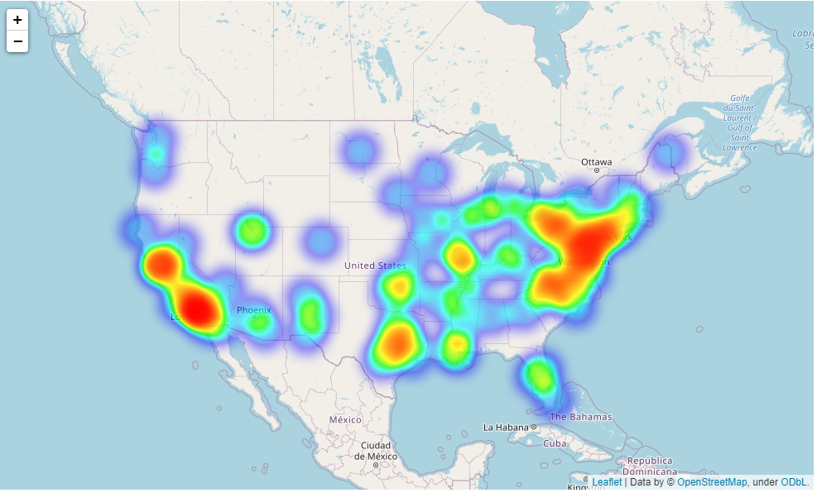
Hypothesis 1: Air pollution varies by region

Slide 5
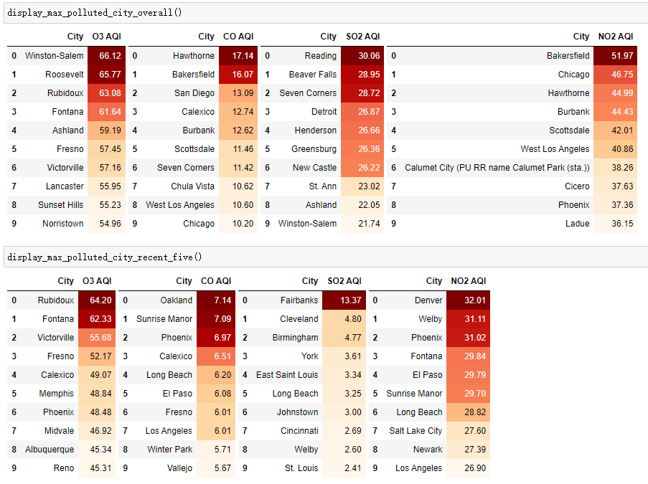
Hypothesis 1: Air pollution varies by region
The cities with the worst average air quality in the past 20 years
The cities with the worst air quality in the last 5 years

Slide 6
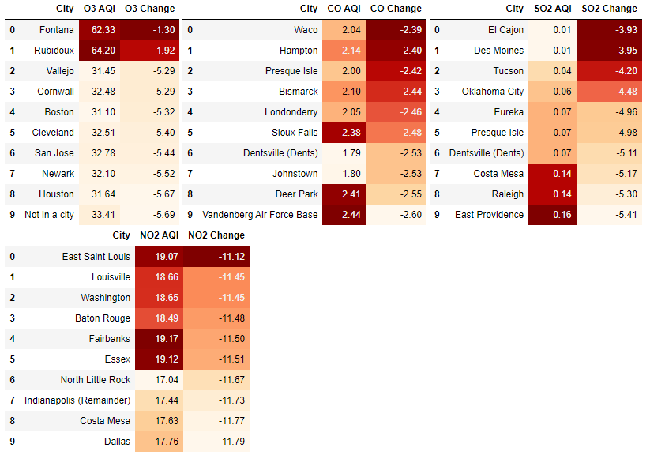
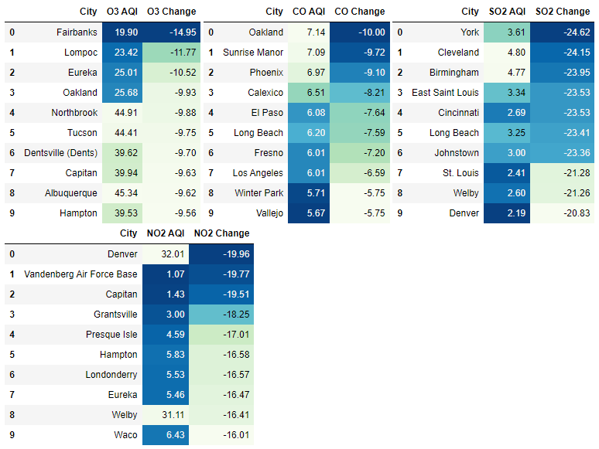
Hypothesis 1: Air pollution varies by region
Air quality has improved a lot over the past 20 years.
Change = AQI(2016~2021) - AQI(2001~2010)

Slide 7
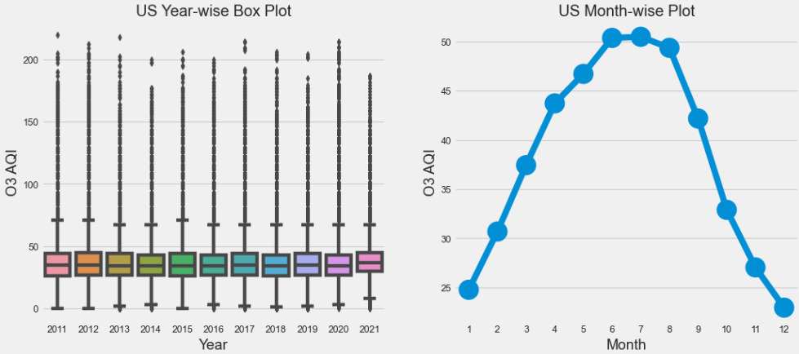
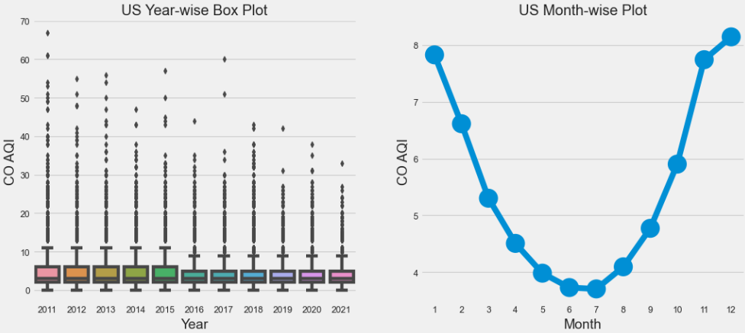
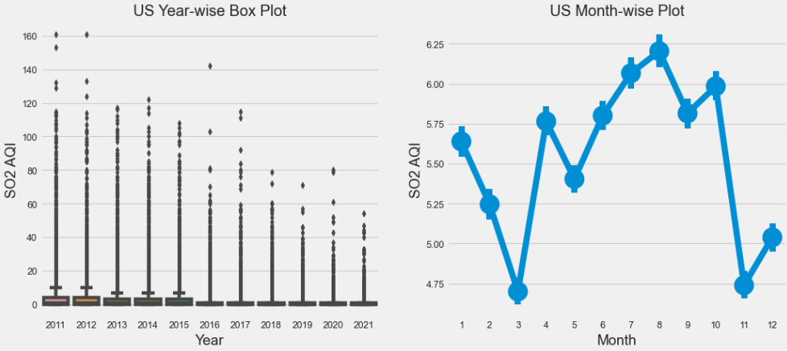
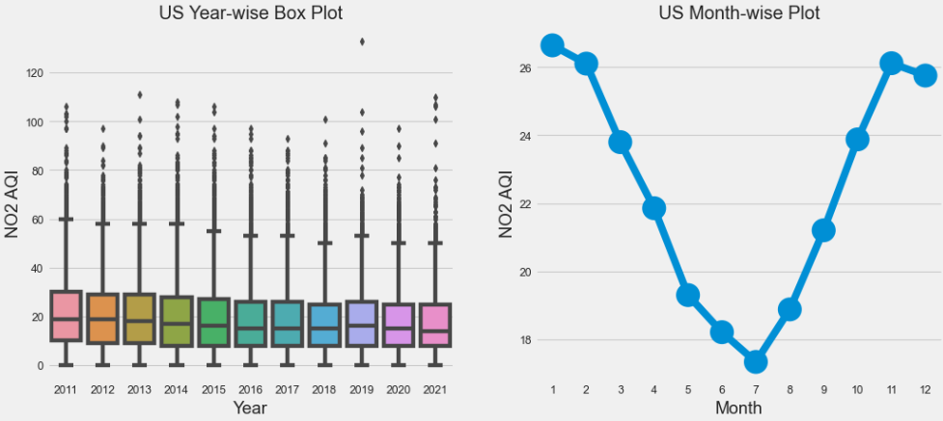
Hypothesis 2: Air pollution has a time difference
AQI(SO2) and AQI(CO) have decreased over the past 10 years.
Each air pollutant has a clear trend of change every year.

Slide 8
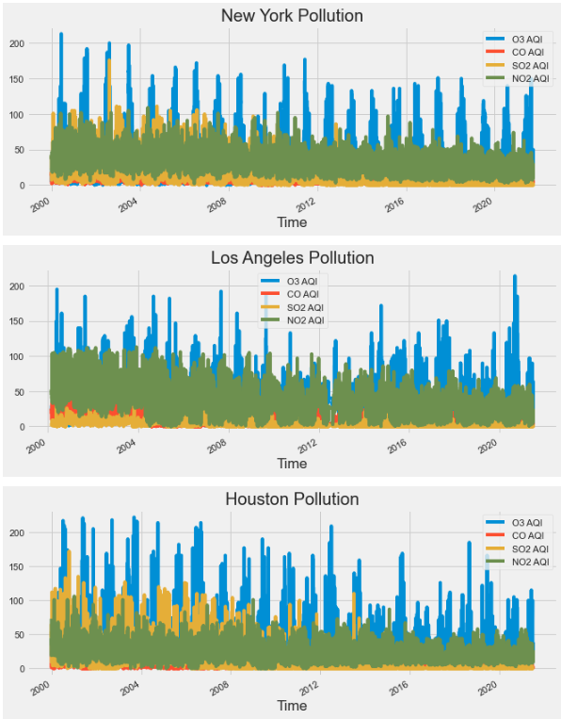
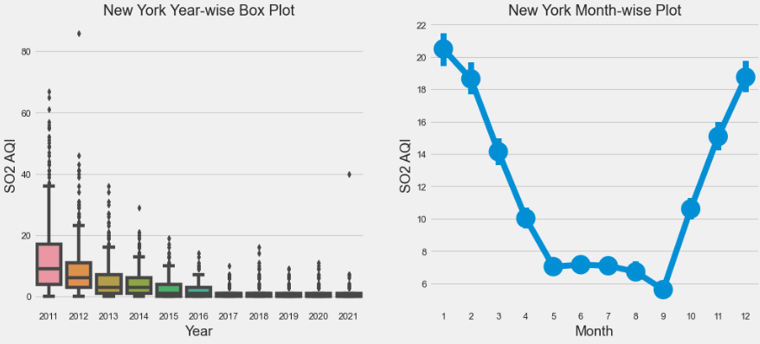
Hypothesis 2: Air pollution has a time difference
Each air pollutant has a clear trend of change every year.
Some cities show adverse AQI pattern with the overall pattern.

Slide 9
Hypothesis Part B: Comparison
Relation between population and air quality two related fields
Relation between state GDP and air quality two related fields
hypothesis 1, 2 using plot, because the rows of data < 100,
No relation between crime case number and air quality per day two unrelated fields
hypothese 3 using corr.() function and Ordinary Least Squares regression (Linear Regression)

Slide 10
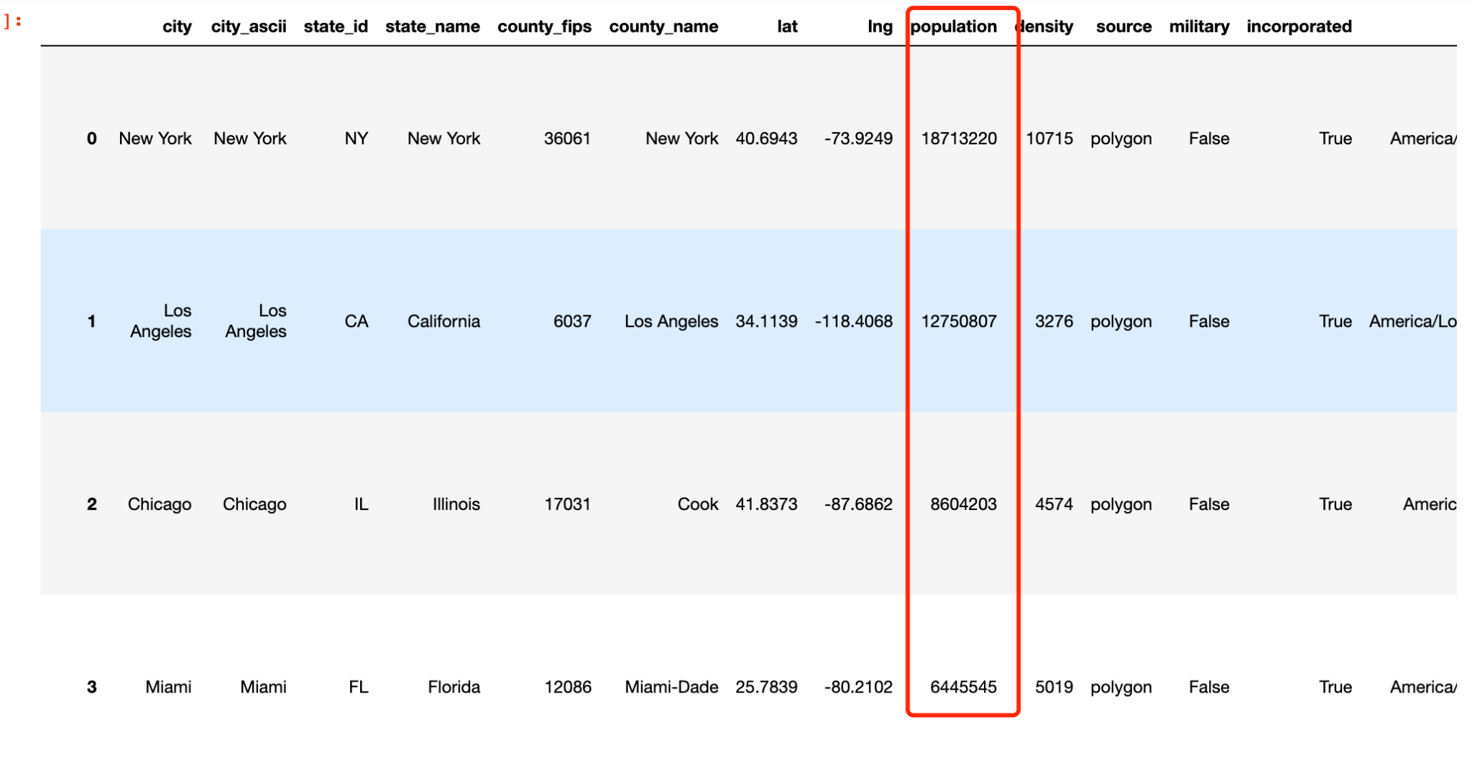
hypothesis 1: Population — Air Quality
US Population 2020

Slide 11
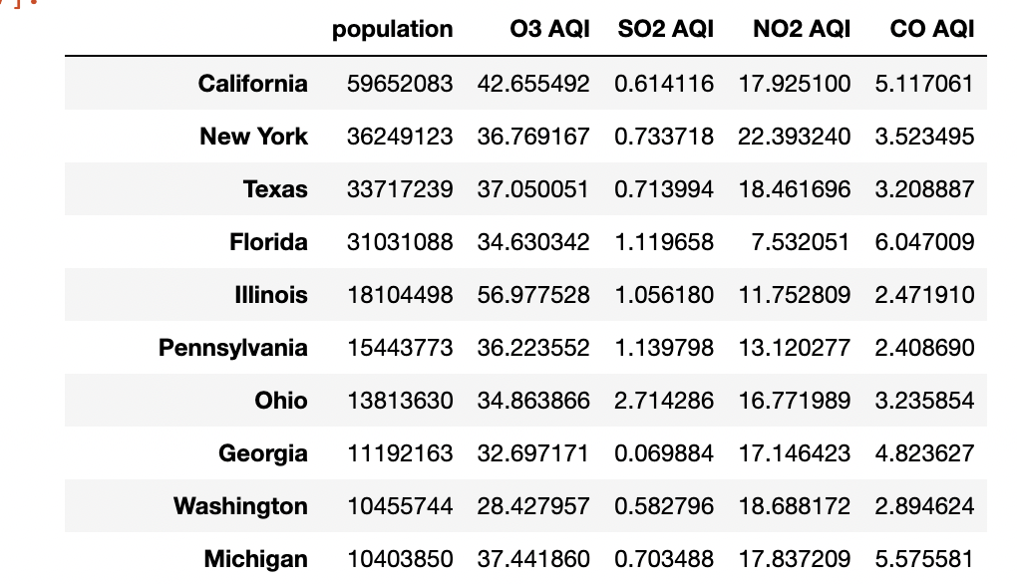
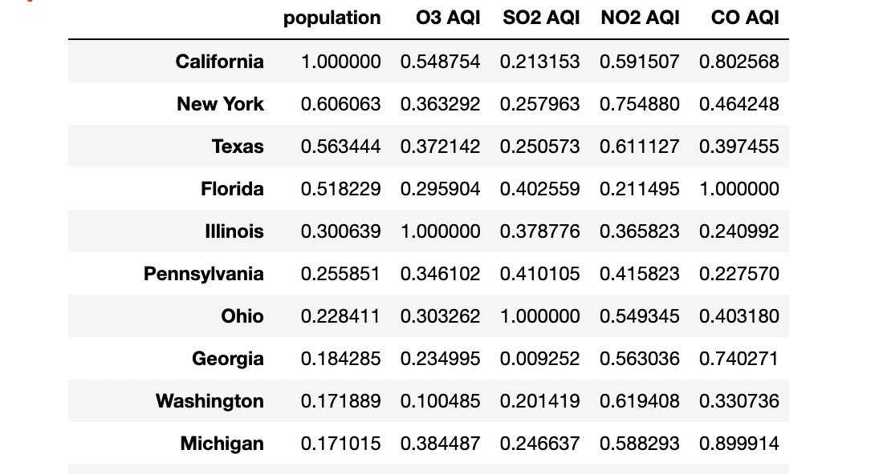
hypothesis 1: Population — Air Quality
Data Normalization
BEFORE AFTER

Slide 12
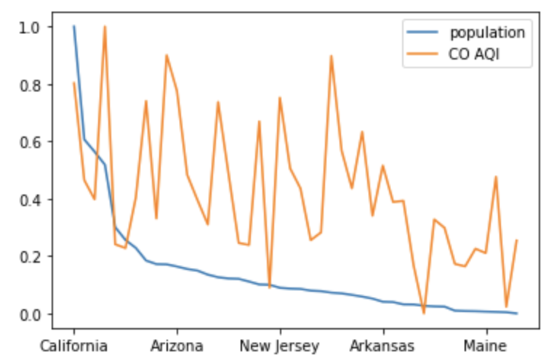
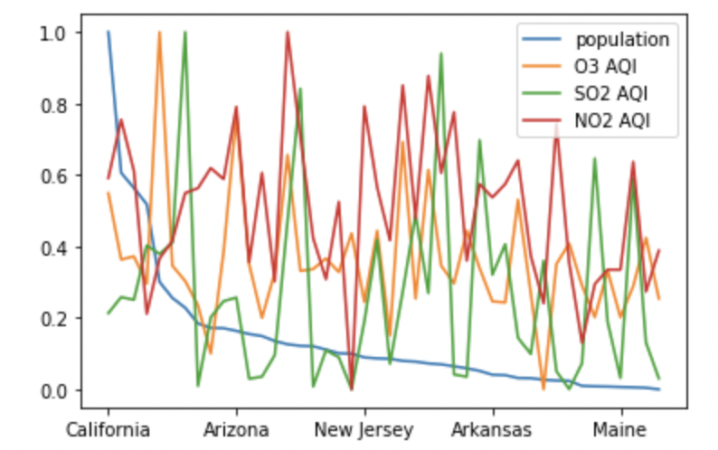
hypothesis 1: Population — Air Quality
population ~ CO AQI (positive) population ~ O3,SO2, NO2(No clear relation)
Conclusion: The state with high population has relatively high carbon monoxide AQI.

Slide 13
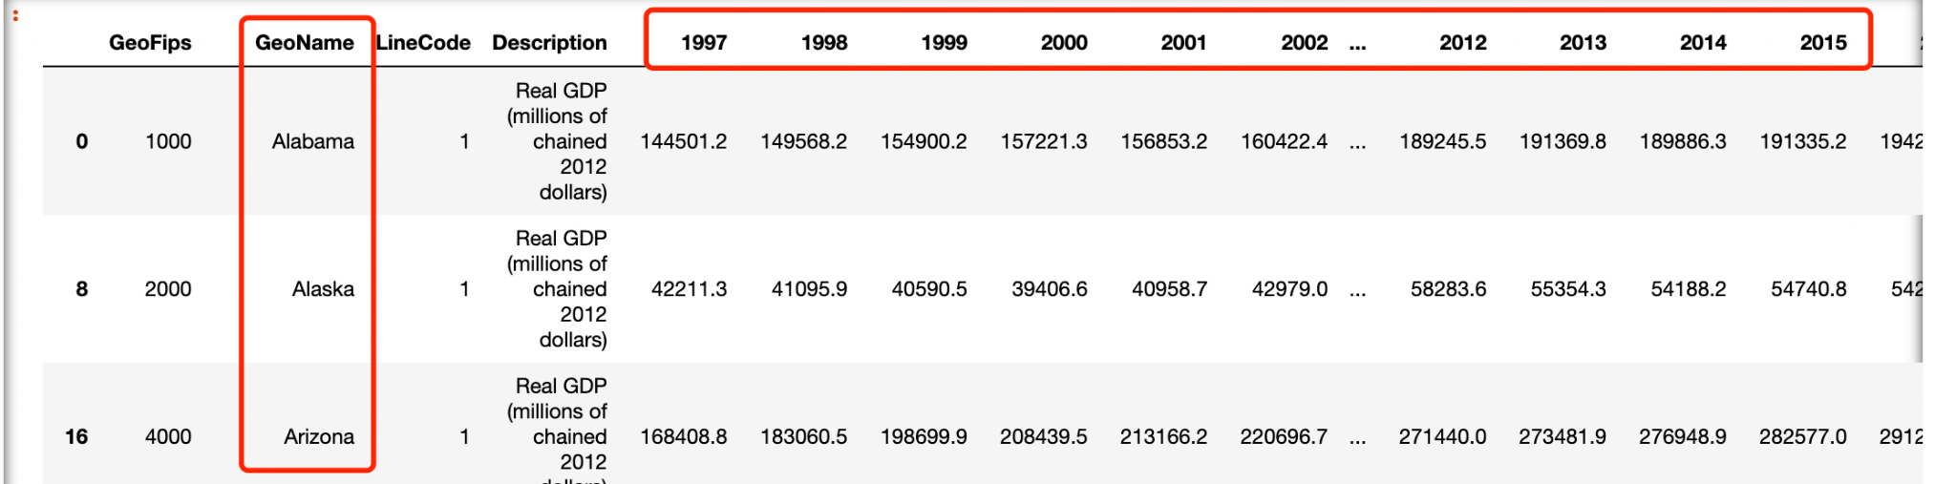
hypothesis 2: GDP — Air Quality
US GDP 1997-2020
Two comparison:
1. Choosing one year and comparing all state’s GDP and Air Quality Index(AQI)(By Year)
2. Choosing one state and comparing GDP’s growing and AQI changes over 20 years.(By State)

Slide 14
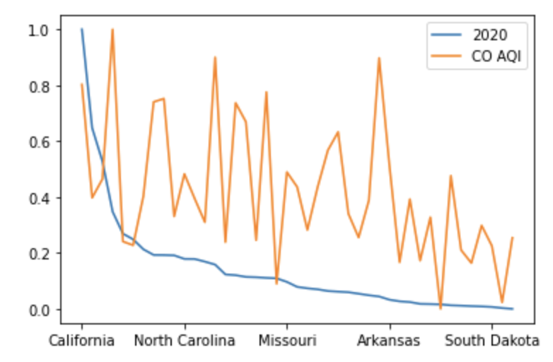
hypothesis 2: GDP — Air Quality(By year)
2020 All States’ GDP ~ CO AQI
Conclusion: State with high GDP has a relatively high CO AQI.

Slide 15
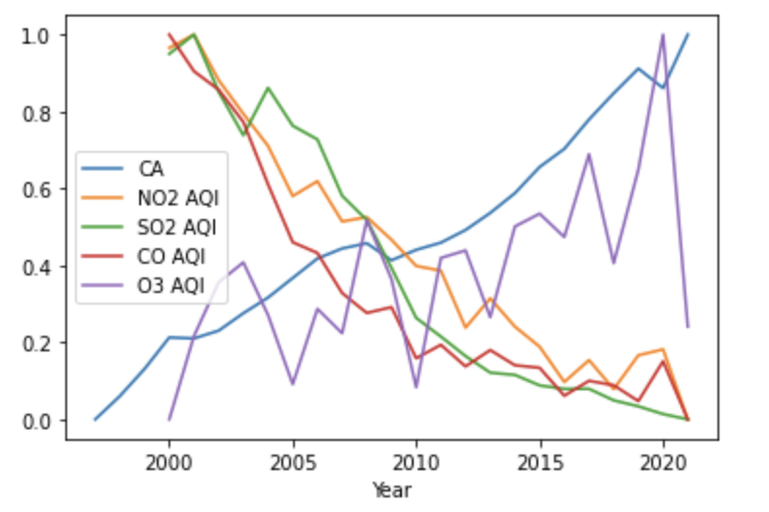
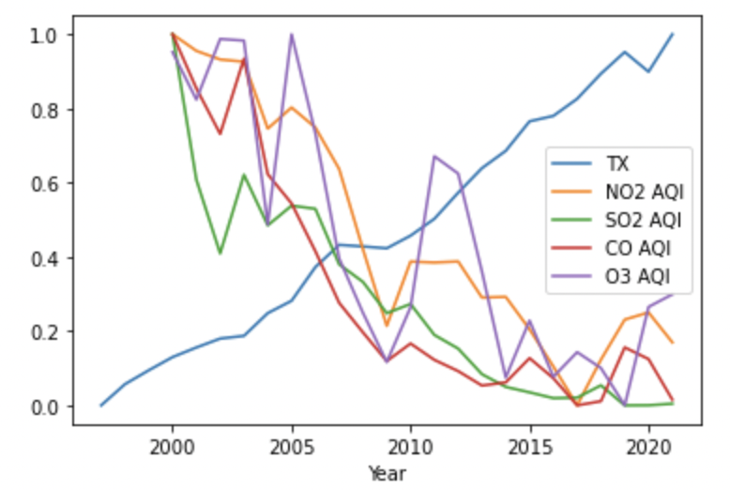
hypothesis 2: GDP — Air Quality(By State)
CA’s GDP ~ AQI
TX’s GDP ~ AQI
Conclusion:
Similarity :Air content of CO, SO2 and NO2 is negatively correlated with the growth of GDP
With one state’s GDP growing, it air quality is being better at the same time.
Notes:
The composition of industries in the two states is different

Slide 16
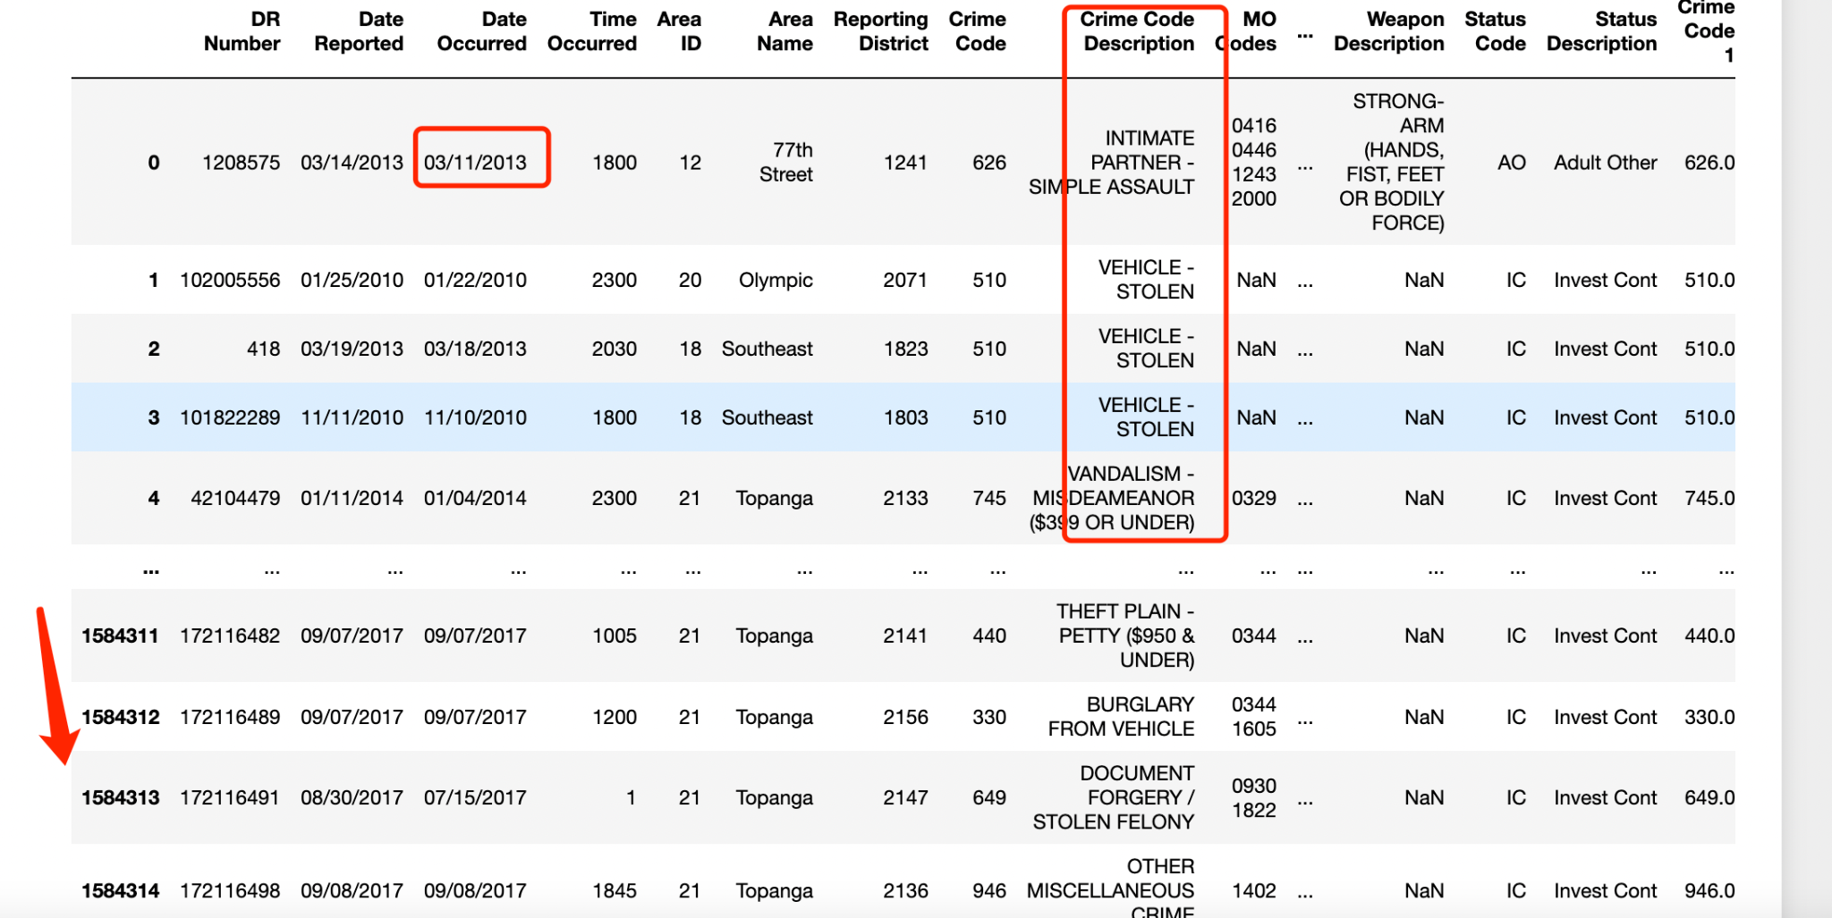
hypothesis 3: Crime — Air Quality
LA crime dataset(2000-2020)

Slide 17
hypothesis 3: Crime — Air Quality
Comparison:
Count the number of crimes per day and analyze its relationship with daily air quality(all cases)
Set ‘crime description’ == ‘with weapon’ and analyze(some cases)
Method: Result Criteria
.corr() # pandas function : value > 0: positive correlation value < 0： negitive correlation
0 - 0.2: weak correlation
0.2 - 0.6 : normal correlation
0.6 - 1.0: high correlation
.ols() # Ordinary Least Squares regression: p-value < 0.05 , r-square: the closer to 1 the better

Slide 18
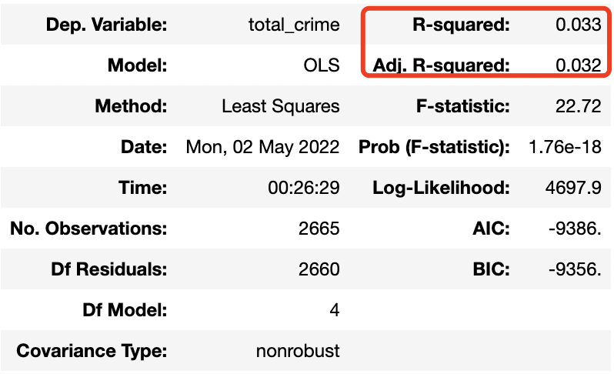
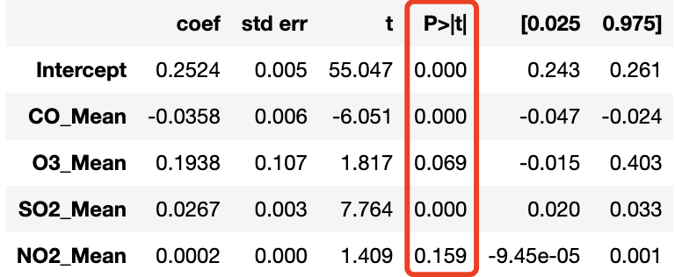
hypothesis 3: Crime — Air Quality(All Cases)
Correlation(~Case number):
SO2 Mean: 0.19
O3 Mean: 0.11
CO Mean: -0.13
NO2 Mean: -0.06
Ordinary Least Squares regression (OLS)：

Slide 19
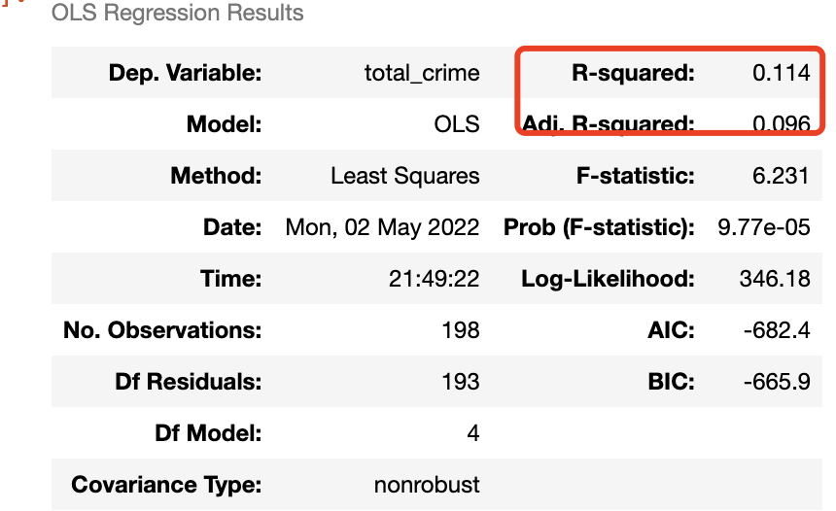
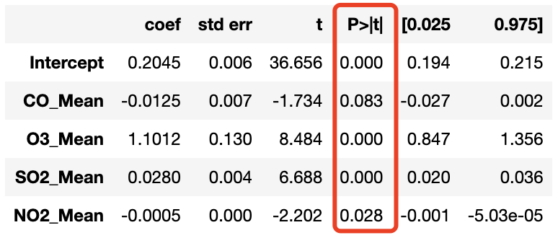
hypothesis 3: Crime — Air Quality(Some Cases)
Correlation(~Case number): Setting SO2 > 0.7 & ‘Crime Description’ like ‘Weapon’
SO2 Mean: -0.13
O3 Mean: 0.51 vs 0.11 4 times than before(all cases)
CO Mean: -0.45 vs -0.13 3 times than before
NO2 Mean: -0.43 vs -0.06 7 times than before
Ordinary Least Squares regression (OLS)：
There is a subtle positive raltion between Ozone between crimes number in lA per day, especially when SO2 > 0.7

Slide 20
Q&A

Slide 21
Thank You

